Slide 1
CSE 220
Jannatun Noor
Jannatun.noor@bracu.ac.bd
Lecture Made by: Aminul Huq

Slide 2
Searching
How would you search for an element in a list of values if all the values are not sorted ?
You would have to go through each elements one by one.
This type of searching is called linear searching.
It is the simplest and most common way of searching an element.
However, it takes too much time to find out a particular element.
It would have to search for all the n items in the array to find one item.

Slide 3
Linear Search
Step 1: Read the search element from the user
Step 2: Compare, the search element with the first element in the list.
Step 3: If both are matching, then display "Given element found!!!" and terminate the function
Step 4: If both are not matching, then compare search element with the next element in the list.
Step 5: Repeat steps 3 and 4 until the search element is compared with the last element in the list.
Step 6: If the last element in the list is also doesn't match, then display "Element not found!!!" and terminate the function.

Slide 4
Binary Search
A simple approach is to do linear search. The time complexity of above algorithm is O(n).
Search a sorted array by repeatedly dividing the search interval in half. Begin with an interval covering the whole array. If the value of the search key is less than the item in the middle of the interval, narrow the interval to the lower half. Otherwise narrow it to the upper half. Repeatedly check until the value is found or the interval is empty.

Slide 5
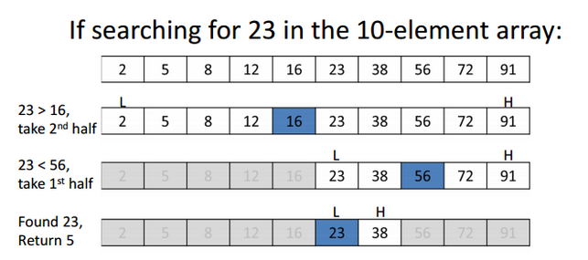
Binary Search
We basically ignore half of the elements just after one comparison.
Compare x with the middle element.
If x matches with middle element, we return the mid index.
Else If x is greater than the mid element, then x can only lie in right half sub-array after the mid element. So we recur for right half.
Else (x is smaller) recur for the left half.

Slide 6
Sorting
It is the technique of how you arrange a set of values.
You can sort it in an ascending or descending manner.
Some popular sorting algorithms are
Bubble Sort
Insertion Sort
Selection Sort

Slide 7
Bubble Sort
Bubble Sort is the simplest sorting algorithm that works by repeatedly swapping the adjacent elements if they are in wrong order.
the worst case scenario is that the array is in reverse order, and that the first element in sorted array is the last element in the starting array, the most exchanges that will be necessary is equal to the length of the array

Slide 8
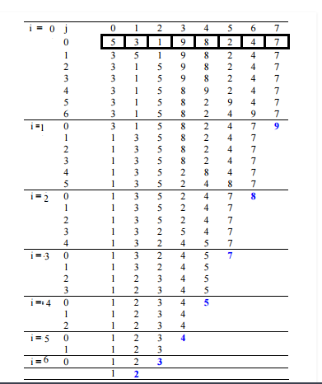
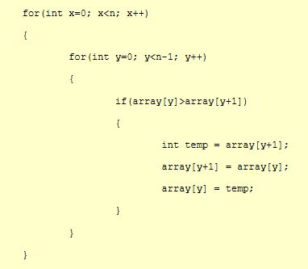
Assume x = i and y =j in this example

Slide 9
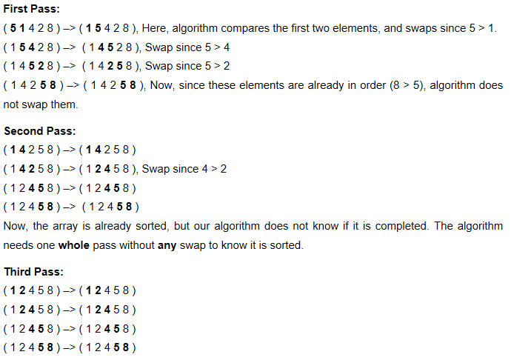

Slide 10
Insertion Sort
Insertion sort is a simple sorting algorithm that works the way we sort playing cards in our hands.
Insertion sort is used when number of elements is small. It can also be useful when input array is almost sorted, only few elements are misplaced in complete big array.
During each iteration, the first remaining element of the input is only compared with the right-most element of the sorted subsection of the array

Slide 11
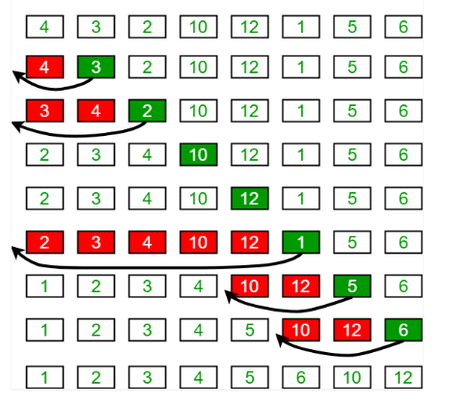

Slide 12
Selection Sort
The selection sort algorithm sorts an array by repeatedly finding the minimum element (considering ascending order) from unsorted part and putting it at the beginning.

Slide 13
